Slide 1
Eartha White Museum
Jordan Gallivan & Kyle White

Slide 2
Background
The Eartha White Museum has requested the implementation of a Virtual Reality museum experience for those individuals who cannot visit the museum in person
Dr Pfeil and xxxx conducted LIDAR scans of the Museum and the process has begun to make an interactable museum experience for the user

Slide 3
The museum
Dedicated to Clara White and het Daughter Dr. Eartha White
Both were dedicated humanitarians
Contains personal belongings of Eartha White
Portrays her daily life
Located at the Clara White Mission building

Slide 4
The Clara white mission
Founded by Eartha White in honor of her mother
Provides meals for the area's homeless population
400-500 people served daily
job training
housing for homeless veterans
Overall, the mission is to reduce homelessness through their programs

Slide 5
Previous Work
The Louvre
Created a VR application to showcase the Mona Lisa in a 3d environment
Peterson Automotive Museum
Showcases the Ford GT40 alongside a 2017 Ford GT
Showcases engines, airflow, and sounds
Guggenhein’s Spiral Staircase
Google Street View

Slide 6
Key features
Heads Up Display (HUD)
Shortest Path Mapping
Selectable and Manipulatable exhibit items

Slide 7
Heads Up Display
Most virtual experiences focus heavily on WIMP selection methods. This project will leverage a HUD to allow the user to scroll through museum sections and featured exhibits
The right side of the display will be nested menus, beginning with the sections of the museum, additionally, a search option will be available
Within each section will be the large exhibits broken down by subsection
The left side of the display will feature section and/or exhibit descriptions when one is selected.

Slide 8
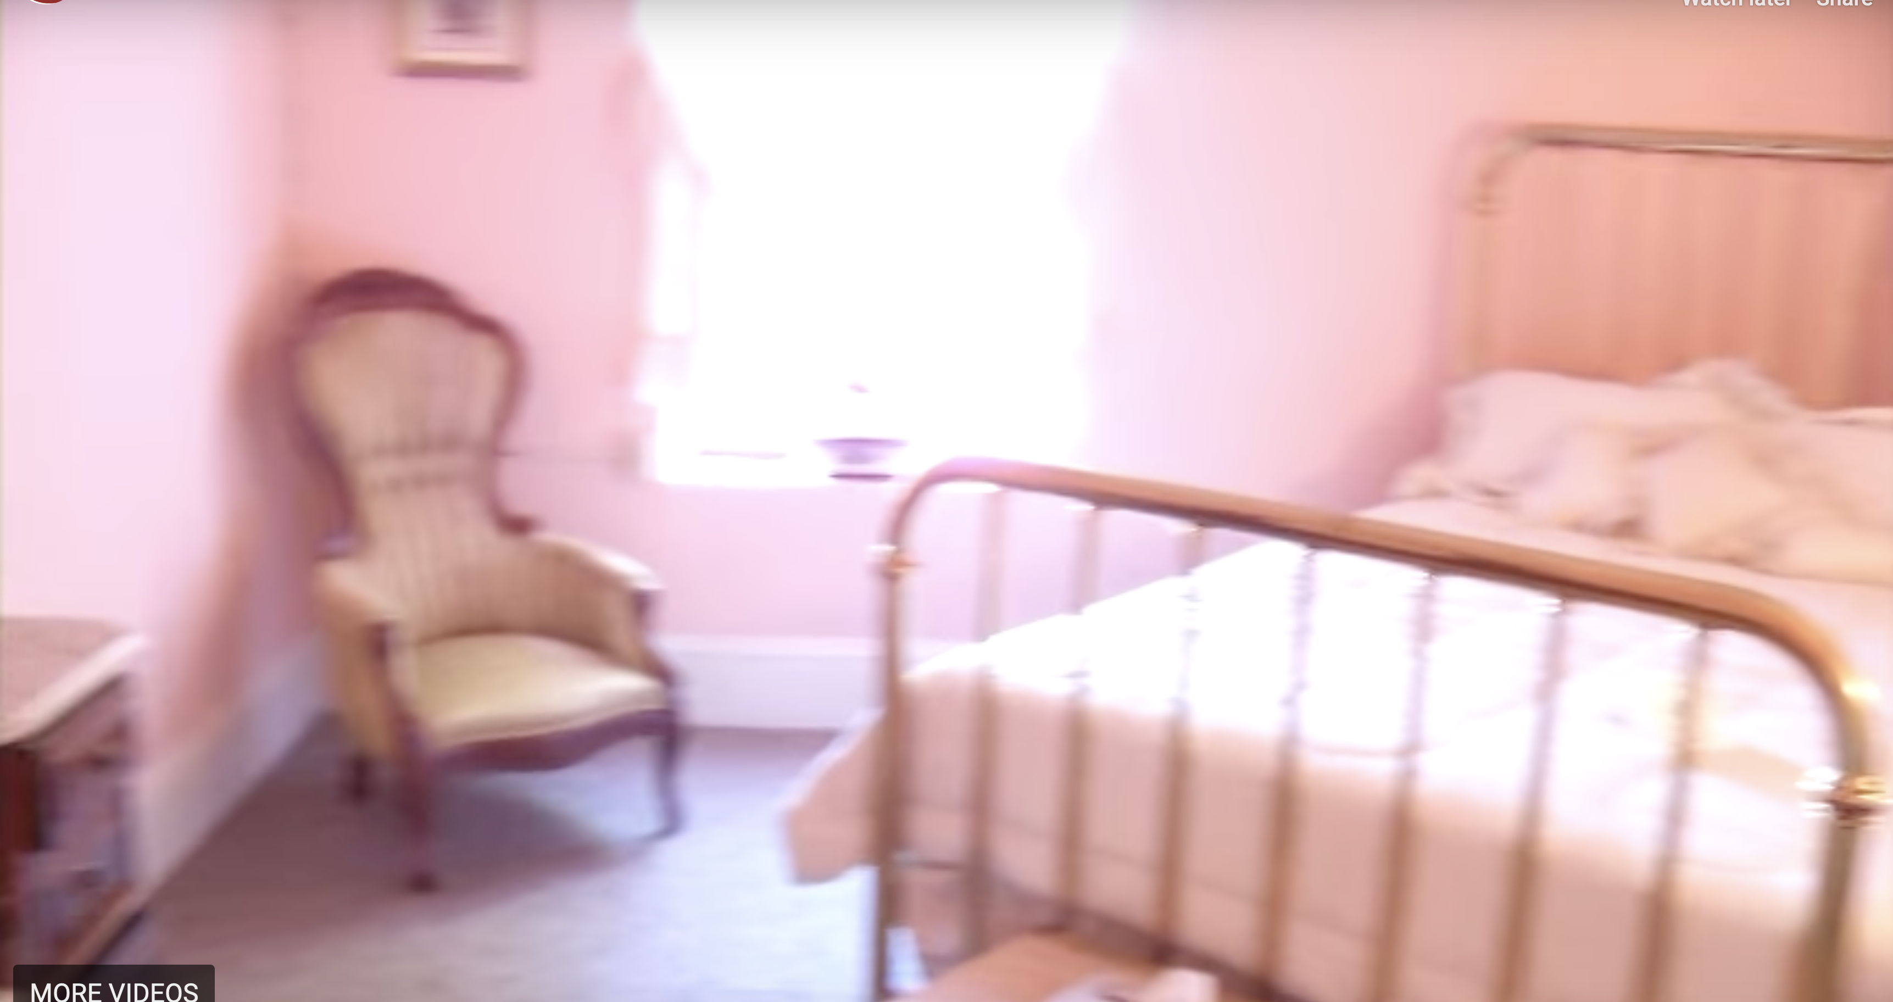
HUD
Guest Room
Ms. White hosted many noteworthy guests over the years, including Mr. and Mrs. Booker T. Washington, Dr. Mary McLeod Bethune, James Weldon Johnson and his brother John Rosamond Johnson, and first lady Eleanor Roosevelt
Eartha’s Room
Kitchen
Guest Room
Dining Room
The Weems
The Parlor

Slide 9
Shortest Path
When a user selects a section or exhibit they wish to visit, the ground will illuminate with a shortest path to the destination.
VR is unique in that a user does not have to look at a map should they choose not to.
Users will be able to add intermediate destinations and be directed accordingly
Should a user deviate from the path, the shortest path will be updated appropriately

Slide 10
Selectable and interactable
The worst part of going to a museum is not being able to touch the exhibits
With assistance from the museum staff, if further scans can be facilitated, the project will implement a feature to allow users to pick up and observe/interact with the items

